Slide 1
T075 - Voice-Based AI Receptionist Agent for Smart College Communication
Rajalakshmi Engineering College, Thandalam - 602105
(An Autonomous Institution, Affiliated to Anna University, Chennai)
Department of CSE
Zeroth Review PPT
Project Domain:
Artificial Intelligence
Natural Language Processing
Team:
Akash N - 2116230701019
Kamalesh S P - 2116230701138
Subramani A - 2116230701347
Guru Raja T - 2116230701502
Mentor:
Mr. B. Bhuvaneswaran
Assistant Professor (SG)
Department of CSE

Slide 2
Abstract
Colleges receive large volumes of telephone inquiries from prospective students, parents, alumni & existing students
Queries span admissions, academic programs, hostel facilities, fees, placements, examinations & student services
Manual reception systems repeatedly answer the same questions, increasing workload & giving inconsistent responses
Long waiting times & limited support outside working hours affect service quality
High call volumes during admission & examination periods make communication management especially challenging

Slide 3
Abstract
Voice-Based AI Receptionist Agent using RAG, LLMs, Speech-to-Text, Text-to-Speech & Agentic AI
Retrieves verified information from a dedicated college knowledge base
Supports natural, human-like voice conversations with callers
Integrates with the college ERP after authentication for personalized services
Intelligently transfers complex queries to a human receptionist when required
Improves communication efficiency & delivers intelligent 24×7 assistance

Slide 4
Problem Statement
High call volumes, no time to answer it all. Colleges get thousands of repetitive calls about admissions, academics, hostel, fees, placements and exams, and small reception teams can’t keep up – especially during peak admission and exam periods.
Manual reception is slow and inconsistent. Answers depend on whoever picks up the phone, so waiting times are long and the information given to callers isn’t always accurate or consistent.
No support outside office hours. Students and parents calling in the evening, on weekends, or during holidays get no response at all, leaving time-sensitive queries unresolved.

Slide 5
Solution
Develop a Voice-Based AI Receptionist using Speech-to-Text (STT), Retrieval-Augmented Generation (RAG), Large Language Models (LLMs), Text-to-Speech (TTS), and Agentic AI.
Automatically answers routine queries such as admissions, fees, departments, hostel, placements, events, and academic regulations, reducing receptionist workload. Provides 24/7 support, ensuring instant responses even outside office hours.
Delivers accurate and consistent information by retrieving answers only from the official college knowledge base using RAG. Supports natural voice conversations by converting speech to text, generating context-aware responses, and replying through natural speech.
Securely integrates with DigiCampus to provide personalized information (attendance, marks, fee status, exam results, and placement eligibility)
Intelligently escalates calls to a human receptionist when confidence is low, the query requires administrative approval, or the caller requests human assistance.

Slide 6
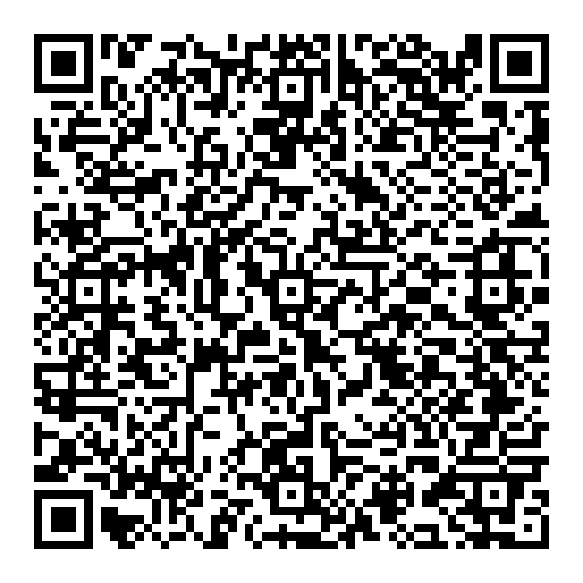
Prototype Demonstration
Prototype Knowledge Base
Rajalakshmi Engineering College – an autonomous institution in Chennai, offering UG & PG engineering programmes
Departments
CSE · IT · ECE · EEE · Mechanical · Civil · AI & DS · MBA
Facilities
Hostel (Boys & Girls) · Library · College Transport · Training & Placement Cell
Authentication
Attendance, Marks, Fees & Exam Results require ERP authentication before access
Scan to Test the Voice AI Receptionist Prototype
Current Prototype: Voice-based AI Receptionist built using ElevenLabs with a custom Knowledge Base
Future Enhancements: RAG + DigiCampus ERP + Twilio Calling + Human Call Transfer

